Slide 1
Marin County
COVID-19 Update
December 27, 2021

Slide 2
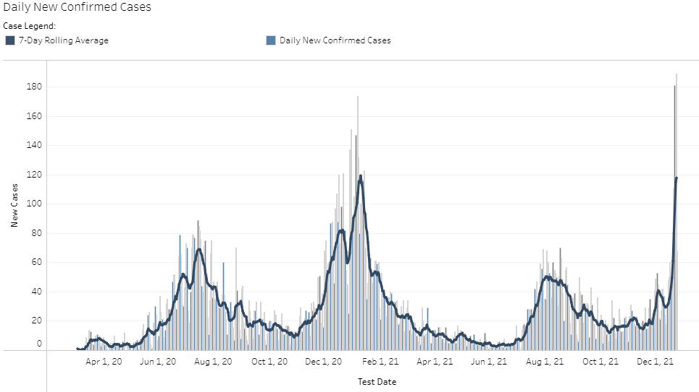
Marin County Daily COVID-19 Cases
Data accessed 12/27/2021

Slide 3
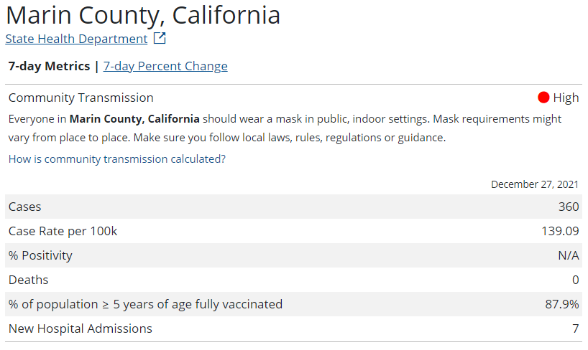
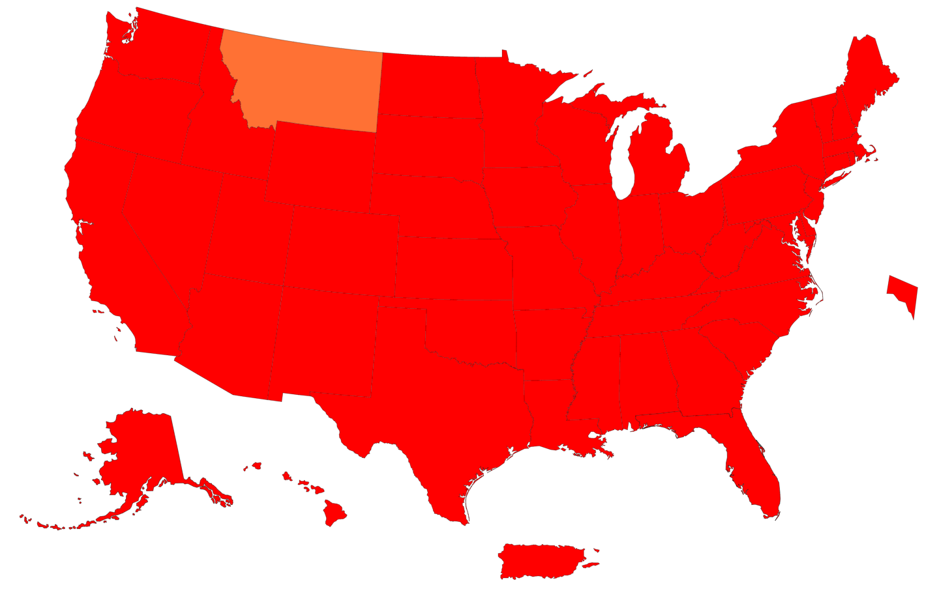
CDC Transmission Level
Community Transmission in the US
 | Low | Moderate | Substantial | High
New cases per 100,000 persons in the past 7 days | <10 | 10-49.99 | 50-99.99 | ≥100
Percentage of positive NAATs tests during the past 7 days | <5% | 5-7.99% | 8-9.99% | ≥10.0%
Data accessed 12/27/2021

Slide 4
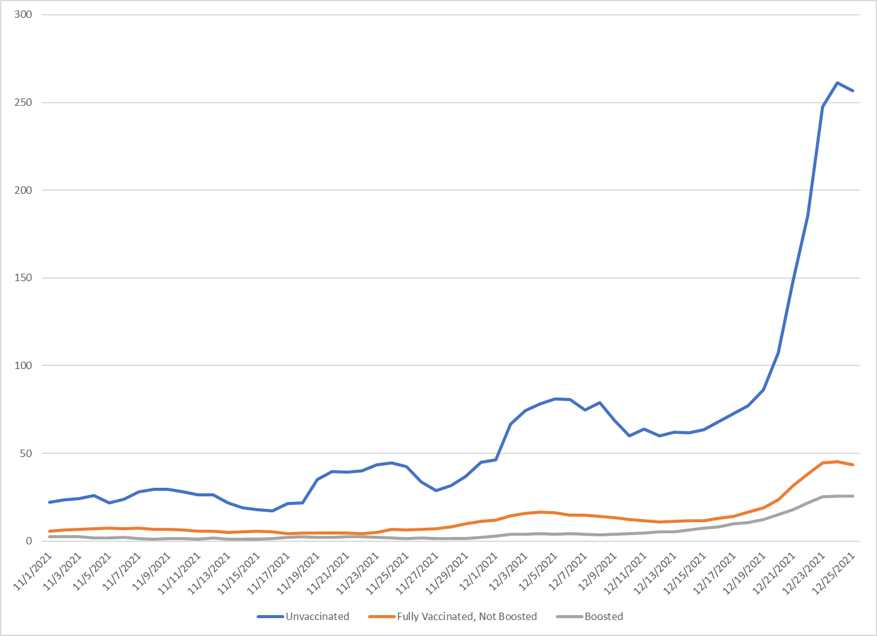
7-Day Case Rate by Vaccination Status
Data accessed 12/28/2021

Slide 5
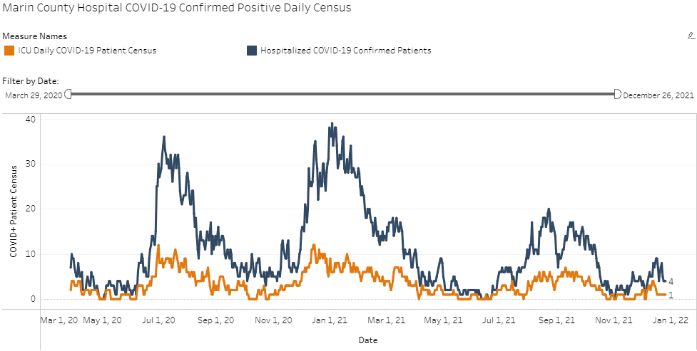
Marin County COVID-19 Hospitalizations
Data accessed 12/27/2021

Slide 6
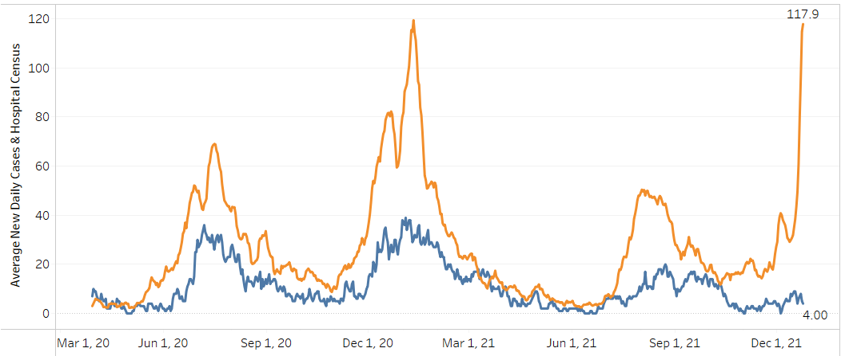
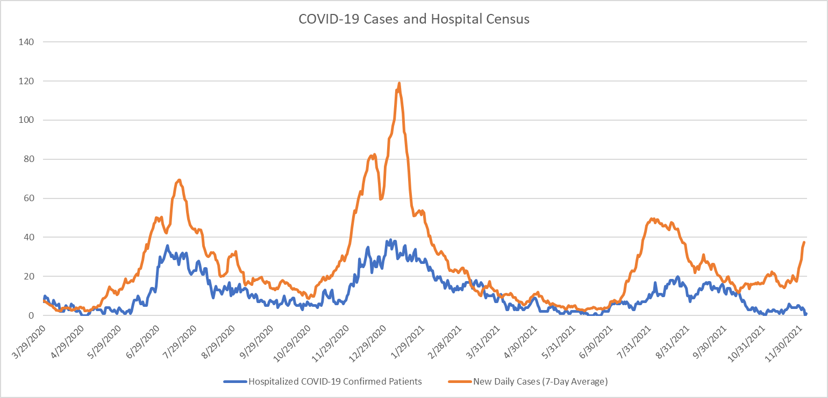
Case and Hospitalization Trends

Slide 7
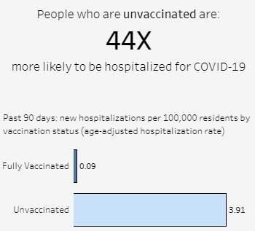
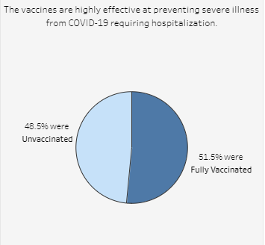
Hospitalization by Vaccine Status
Data accessed 12/23/2021
Notes:
placeholder for new smart goal: 75% of eligible 65+ with booster or third dose

Slide 8
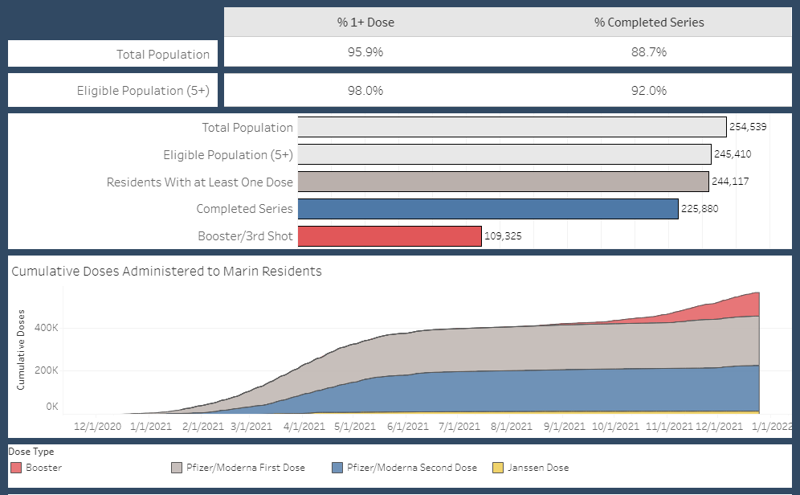
COVID-19 Vaccination Rates: Marin County
Data accessed 12/27/2021

Slide 9
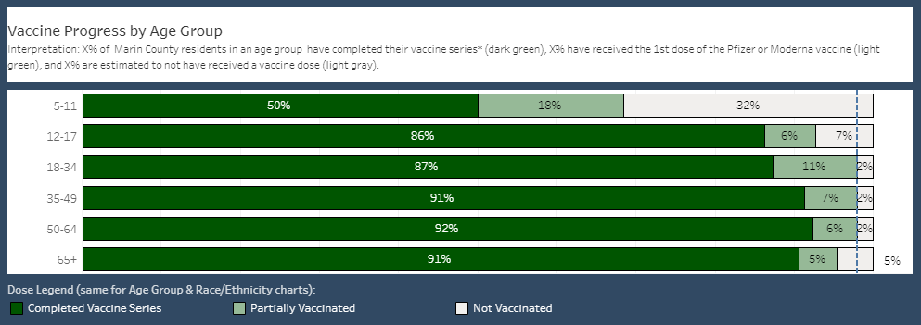
Vaccination Progress by Age
Data accessed 12/27/2021

Slide 10
Return to School Testing
Staff and students test the day before scheduled return to school, following instructions provided.
  Voluntary, strongly recommended.
Families report results, positive and negative, either to Primary.Health or HHS “JOT” form using the QR code provided in the instructions
Positive results:
  Isolate at home
  Families call school to notify staff
  HHS Schools Team sends list of positive cases to each school PHL

Slide 11
Setting Expectations
There will be positive results in most or all schools
1-2 percent positivity rate broad estimate
Prepare for staff and students to be out sick for one week

Slide 12
New Isolation Guidance: Provisional
Stay home for at least 5 days.
Isolation can end on or after day 5 if symptoms are not present or are resolving and a diagnostic specimen is collected on day 5 or later and tests negative.
If unable to test or choose not to test, and symptoms are not present or are resolving, isolation can end on day 10.
If fever is present, isolation should be continued until fever resolves. If symptoms, other than fever, are not resolving within 5 days, refer to CDC guidance for discontinuing isolation.
Wear a mask around others for 5 additional days, especially in indoor settings.

Slide 13
HHS Schools Team Support
Sending automated messages to positive cases with instructions for isolation/quarantine, notifying close contacts, and returning to school
Training staff from CDPH to assist schools with outbreak response
PHLs will receive email confirmation of positive case reports with instructions on how to respond
Hosting weekly meetings with School RNs and PHLs with time for Q&A
Updating written guidance and posting on the PHL and public facing websites
Policy/guidance updates as needed in between meetings

Slide 14
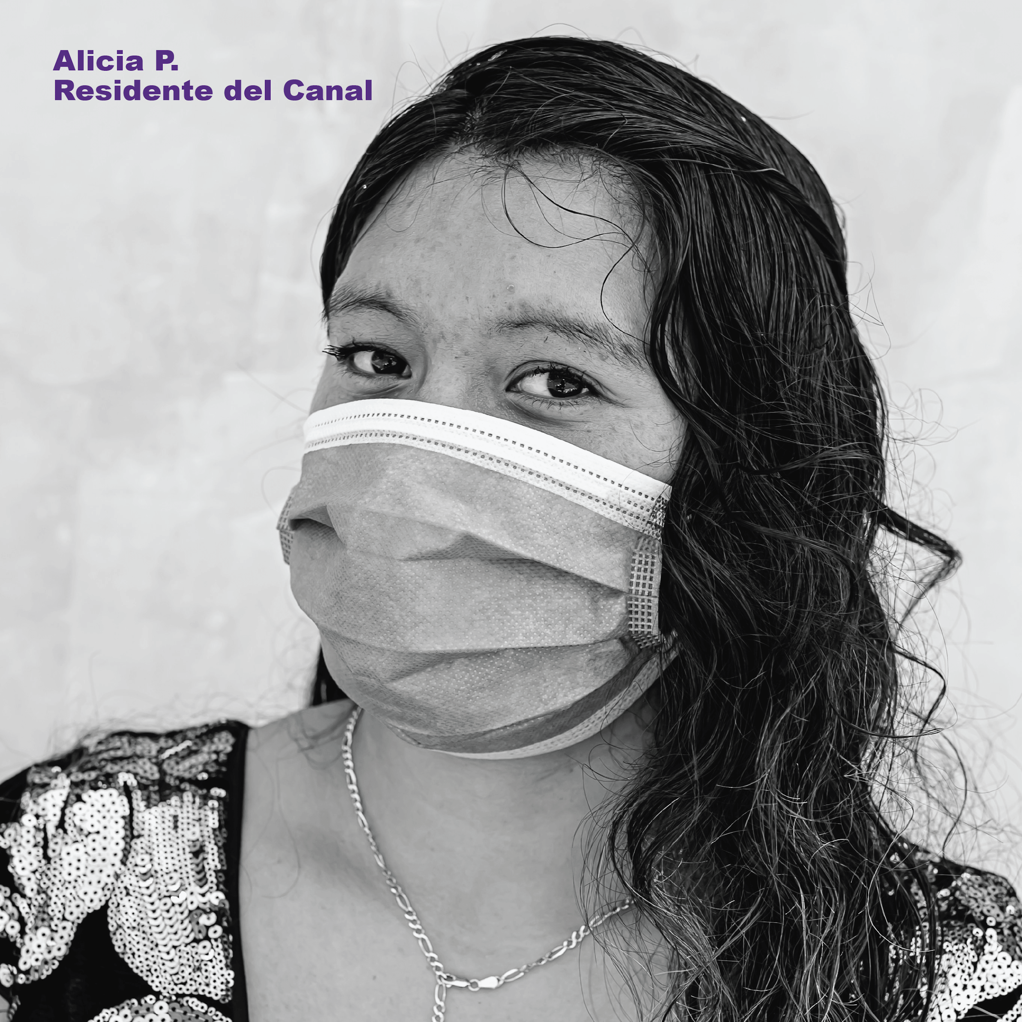

Thank you

